Slide 1

CSET 150
Network Design and Management
Dr. Mahboob Qaosar
Associate Professor, CSE, RU
Week # 1

Slide 2
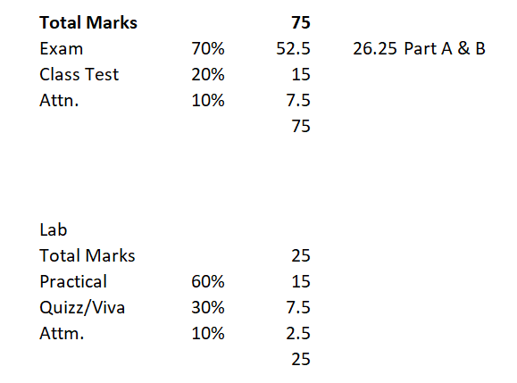
CSET 150 and CSEL 150
Network Design and Management

Slide 3
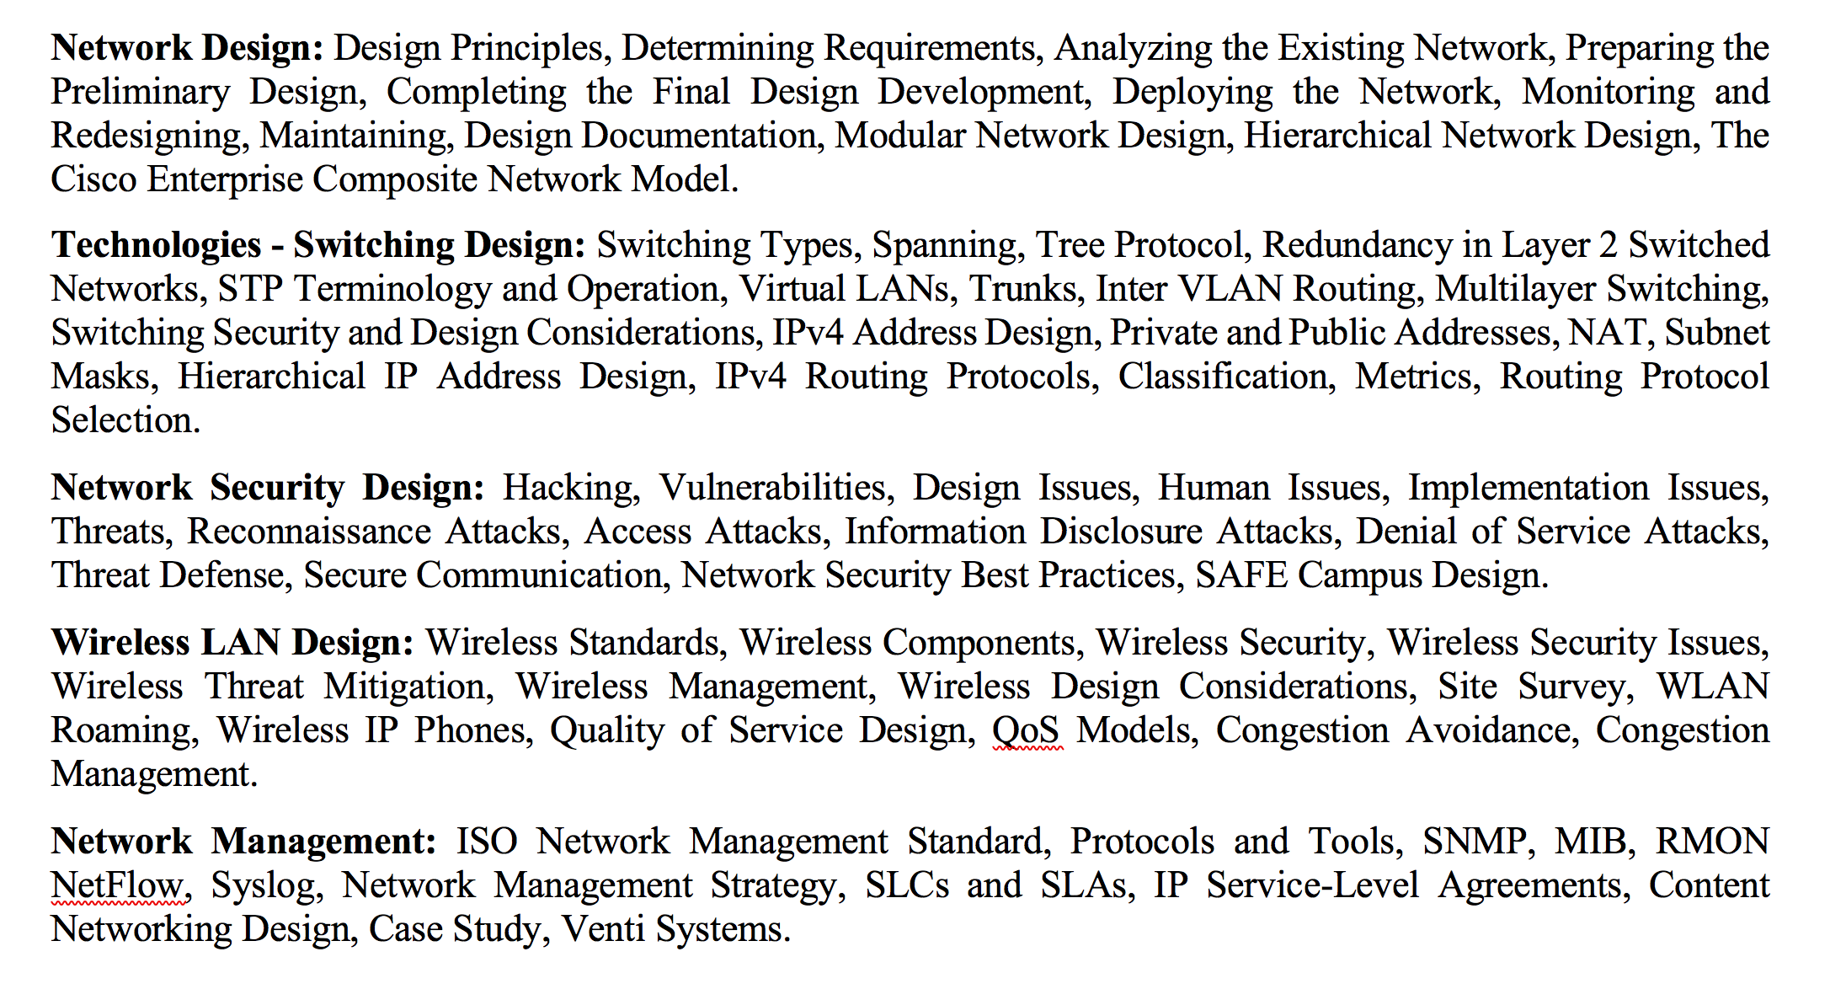
CSET 150
Network Design and Management
PART A
PART B

Slide 4
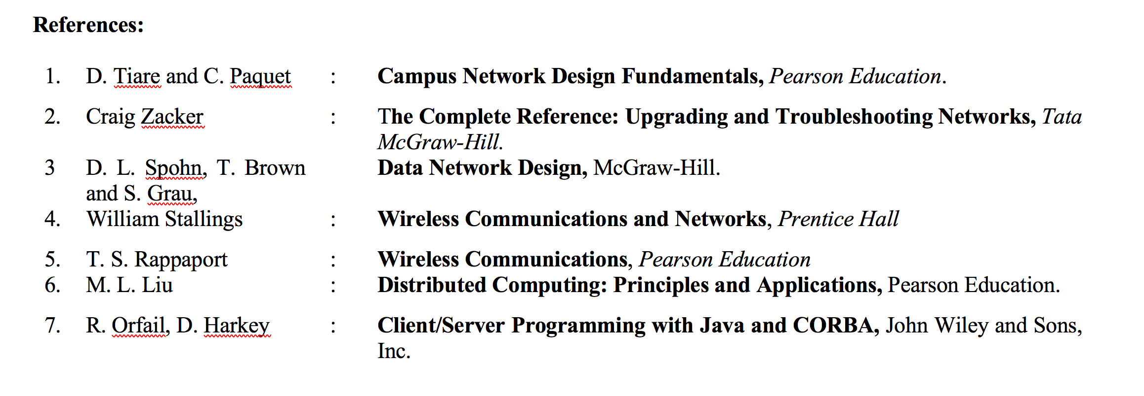

Slide 5
Fundamental Idea
Network Card (LAN Card)
Network Card (LAN Card)

Slide 6
Fundamental Idea
HUB/ SWITCH
Protocol

Slide 7
RJ-45 Connector
UTP –Unshielded Twisted Pair

Slide 8
Lab Work

